Slide 1
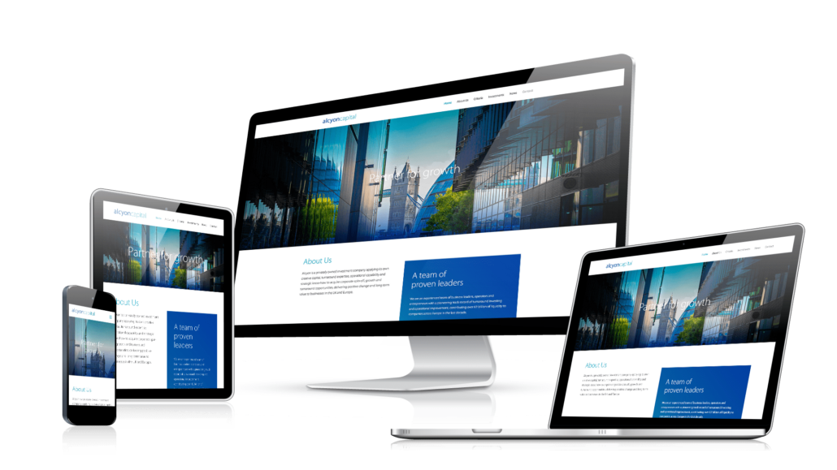
Media Queries
Responsive Web Design
SoftUni Team
Technical Trainers
Software University
https://softuni.org

Slide 2
Table of Contents
Responsive Web Design
Media Queries
Media Types
Media Feature Rules
CSS Breakpoints
DevTools
Mobile First Design
Logical Operators
2
Notes:
2

Slide 3
Have a Question?
sli.do
#front-end
Notes:
3

Slide 4

Responsive Web Design
Resize, hide, shrink, or enlarge a website to make it look good on all devices

Slide 5
What is Responsive Web Design?
Automatically resize, hide, shrink, or enlarge, a website, to make it look good on all devices (desktops, tablets, and phones)
Setting the Viewport:
Add the following <meta> element:
This will give the browser instructions on how to control the page's dimensions and scaling
<meta name="viewport" content="width=device-width, initial-scale=1.0">

Slide 6
Components of Responsive Design
Responsive website design consists of the following three main components:
Flexible layouts
Using a flexible grid to create the website layout
That will dynamically resize to any width
Media queries
Allow designers to specify different styles for specific browser and device circumstances

Slide 7
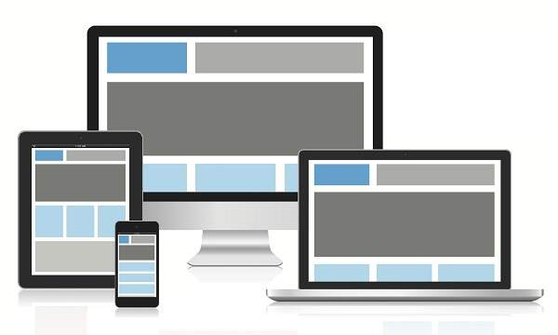
Components of Responsive Design
Flexible Media
Makes media (images, video and other format) scalable

Slide 8

Benefits of Using a Responsive Website
Increased traffic from mobile users
Lower cost and website maintenance
Provides a seamless User Experience (UI)
Adapts easily to any screen size
Improves your SEO efforts

Slide 9
Why Responsive Website Design Works?
Google prioritizes responsive websites
50% of total eCommerce revenue comes from mobile
94% of people judges websites on responsive web design
Almost 60% of all Internet access is done through the phone
77% of adults own a smart phone
72% of people want Mobile-Friendly websites
Responsive design integrates social media

Slide 10
What is a Media Query?
Media Queries are a feature of CSS that enable webpage content to adapt to different screen sizes and resolutions
They are a fundamental part of responsive web design and are used to customize the appearance of websites for multiple devices
10

Slide 11
Media Query Syntax
A media query consists of a media type and can contain one or more expressions, which resolve to either true or false
The result of the query is true if the specified media type matches the type of device the document is being displayed on
Unless you use the not or only operators, the media type is optional, and the all type will be implied
@media (min-width: 400px) and (max-width: 800px) {
/*...*/
}

Slide 12
Media Query Syntax
A media type, which tells the browser what kind of media this code is for (e.g. print, or screen)
A media feature rule - test that must be passed for the contained CSS to be applied
A set of CSS rules that will be applied if the test passes and the media type is correct

Slide 13
Media Queries
Media queries in CSS3 look at the capability of the device
Media queries can be used to check many things, such as:
width and height of the viewport
width and height of the device
orientation (is the tablet/phone in landscape or portrait mode?)
resolution

Slide 14
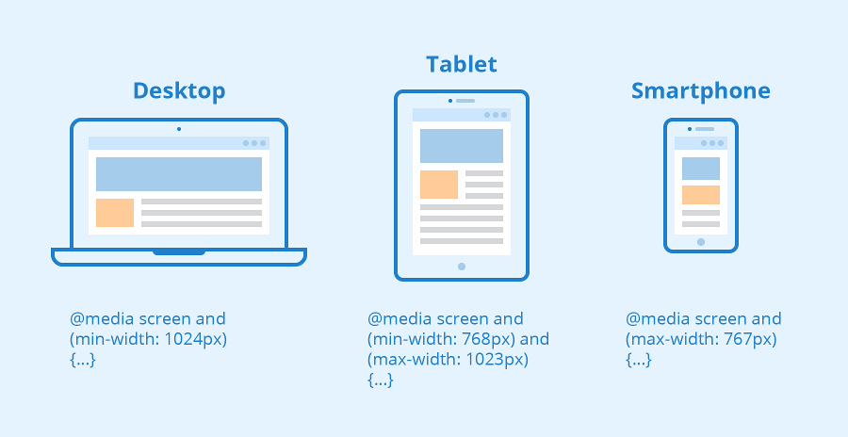
Media Types
Introduction to Media Types

Slide 15
CSS Media Types
Media Types describe the general category of a given device:
all - used for all media type devices
print - used for printers
screen - used for computer screens, tablets, smart-phones etc.
speech - used for screen readers that "reads" the page out loud

Slide 16
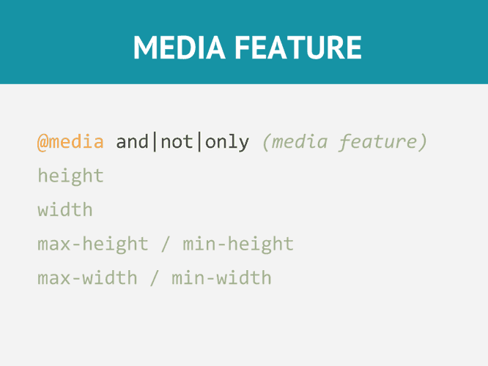
Media Feature Rules
Rule used in media queries to apply different styles for different media types/devices

Slide 17
Media Feature Rules
We can apply CSS if the viewport is under or above an exact width - using min-width, max-width
@media screen and (max-width: 400px) {
body {
color: blue;
}
}
@media screen and (min-width: 600px) {
body {
color: red;
}
}

Slide 18
Media Feature Rules
Orientation - allows to test for portrait or landscape mode
To change the body text color if the device is in landscape orientation:
@media (orientation: landscape) {
body {
color: red;
}
}

Slide 19
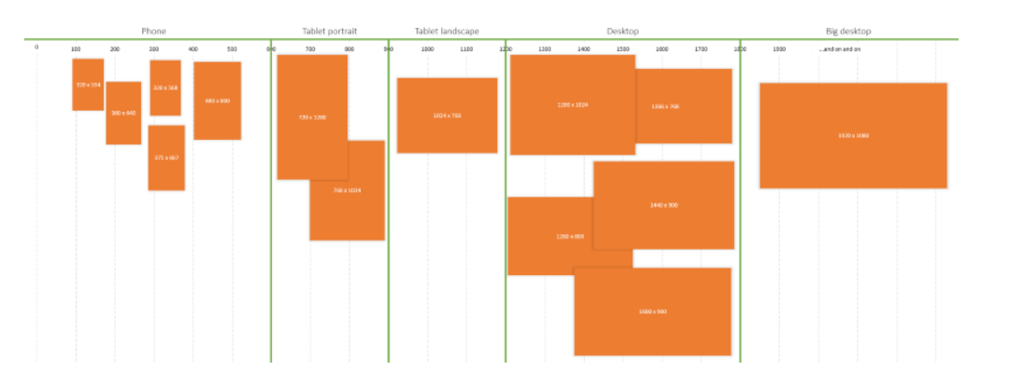
CSS Breakpoints
Breakpoints for different devices

Slide 20
CSS Breakpoints
Points where the website content responds according to the device width, allowing you to show the best possible layout to the user
CSS breakpoints are also called media query breakpoints, as they are used with media queries
See more about setting the right breakpoints here

Slide 21
Which breakpoints to use?
@media (max-width: 599px) {
/* For phone only ...*/
}
@media (min-width: 600px) {
/* For tablet portrait up ...*/
}
@media (min-width: 900px) {
/* For tablet landscape up ...*/
}
@media (min-width: 1200px) {
/* For desktop up ...*/
}
@media (min-width: 1800px) {
/* For big desktop up ...*/
}

Slide 22
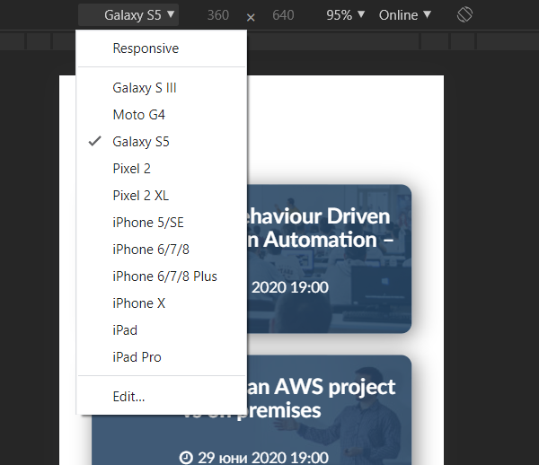
DevTools
Browser DevTools

Slide 23
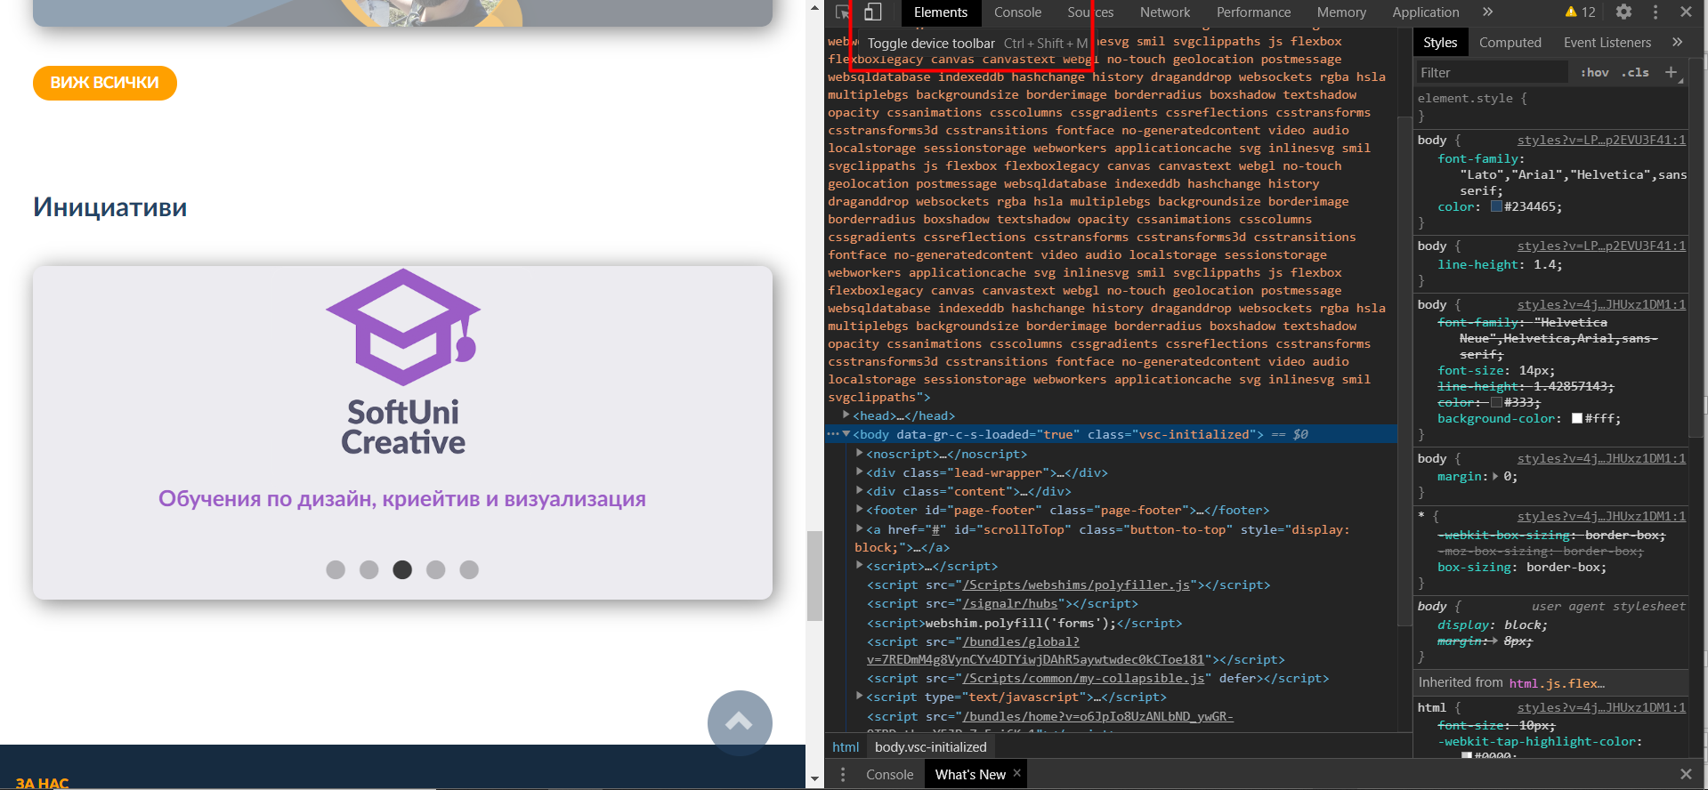
Browser DevTools

Slide 24
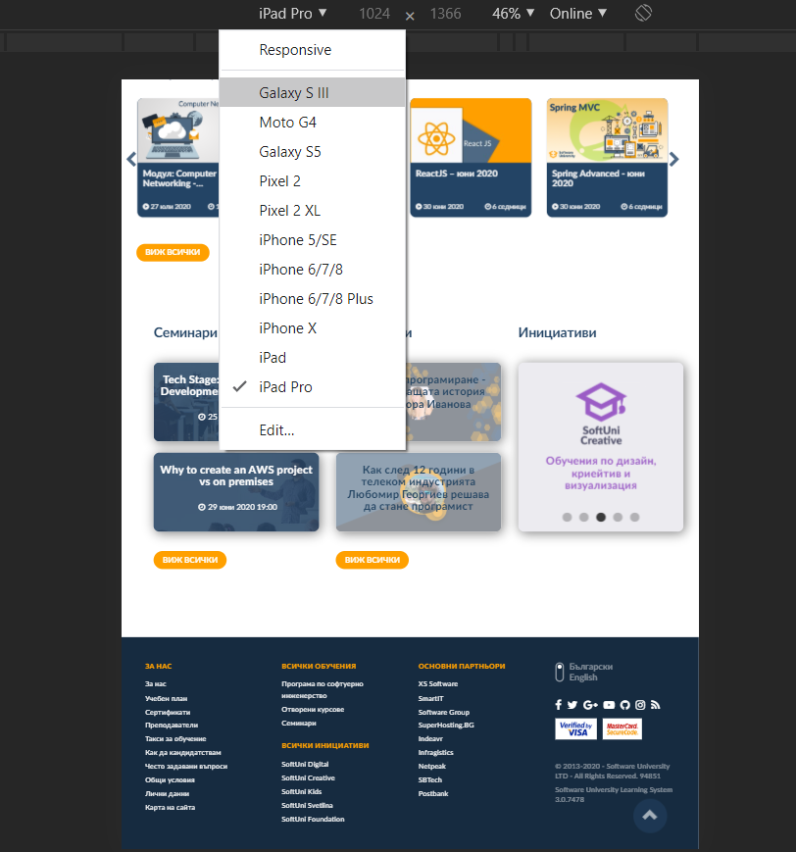
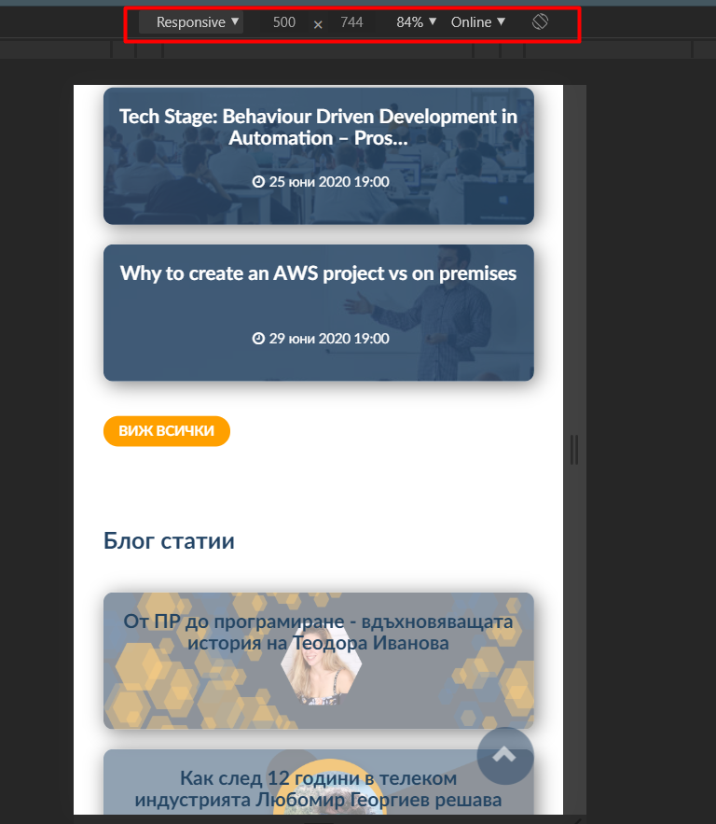
Browser DevTools

Slide 25
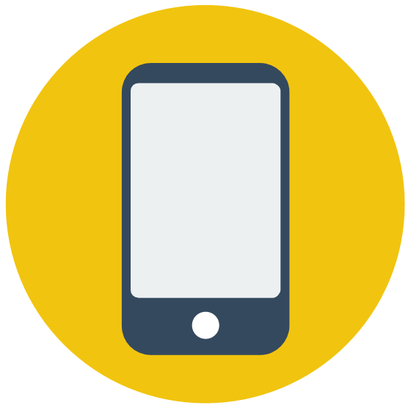
Mobile First Design

Slide 26
Mobile First Design
We start the product design from the mobile which has more restrictions, then expand its features to create a tablet or desktop version
Mobile-first = Content-first
People have spent more and more time on the internet from mobile ends

Slide 27



Logical Operators
Media Queries Conditions

Slide 28
Logical Operators
The logical operators not, and, and only can be used to compose a complex media query
and - combining multiple media features
@media screen and (min-width: 400px) and (orientation: landscape) {
body {
color: blue;
background: yellow;
}
}

Slide 29
Logical Operators
not - negate a media query
only - used to apply a style only if an entire query matches
, (comma) - commas are used to combine multiple media queries into a single rule
@media not all and (orientation: landscape) {
body {
color: blue;
}
}

Slide 30

Summary
What is Responsive Web Design?
What are Media Queries?
Media Feature Rules
Media Types and CSS Breakpoints
DevTools
Mobile First Design
Logical Operators
Notes:
30

Slide 31
Questions?
Notes:
31

Slide 32














SoftUni Diamond Partners

Slide 33

License
This course (slides, examples, demos, exercises, homework, documents, videos and other assets) is copyrighted content
Unauthorized copy, reproduction or use is illegal
© SoftUni - https://softuni.org
© Software University - https://softuni.bg
Notes:
33

Slide 34
Trainings @ Software University (SoftUni)
Software University - High-Quality Education, Profession and Job for Software Developers
softuni.bg
Software University Foundation
softuni.foundation
Software University @ Facebook
facebook.com/SoftwareUniversity
Software University Forums
forum.softuni.bg
Notes:
34

